Slide 1
Object Oriented Programming Java

Slide 2
What is Java
Java is:
platform independent programming language
similar to C++ in syntax
similar to Smalltalk in mental paradigm
Interpreted
A general purpose, high-level programming language with support for object-oriented programming.
A collection of wide-ranging application programming interfaces (APIs).
A self-contained runtime system.
A complete set of development tools.

Slide 3
Java has some interesting features:
automatic type checking,
automatic garbage collection,
simplifies pointers; no directly accessible pointer to memory,
simplified network access,
multi-threading!
Java is not…
An internet-only programming language.
Difficult.
JavaScript.

Slide 4
HISTORY OF JAVA
Java was created by a team of programmers (James Gosling, Patrick Naught on, Chris Warth, Ed Frank, and Mike Sheridan) at sun Microsystems of U.S.A in 1991.
This language was initially called “Oak” by James Gosling but renamed “Java” in 1995.
Java was designed for the development of software for consumer electronics devices like TVs, VCRs, and such electronics machines.
When the World Wide Web became popular in 1994, sun realized that Java was the perfect programming language for the Web.
Late 1995 and early 1996 they released Java & it was instant success.

Slide 5
Why Java?
The answer is that Java enables users to develop and deploy applications on the Internet for servers, desktop computers, and small hand-held devices. The future of computing is being profoundly influenced by the Internet, and Java promises to remain a big part of that future. Java is the Internet programming language.
Java is a general purpose programming language.
Java is the Internet programming language.

Slide 6
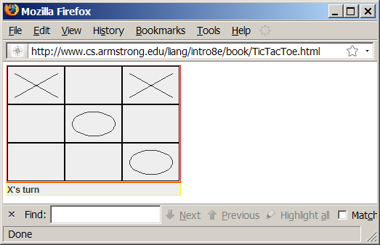
Examples of Java’s Versatility (Applets)

Slide 7
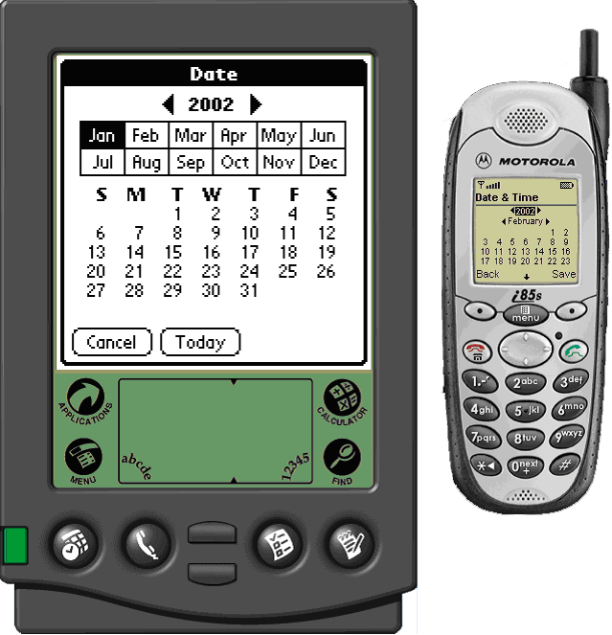
PDA and Cell Phone

Slide 8
How it works…!
Class Loader
Byte code
Verifier
Java Class
Libraries
Java
Source
(.java)
Java
Interpreter
Just in Time
Compiler
Java
Byte codes
move locally
or through
network
Java
Virtual
machine
Java
Compiler
Runtime System
Java
Byte code
(.class )
Operating System
Hardware

Slide 9

How it works…!
Java is independent only for one reason:
Only depends on the Java Virtual Machine (JVM),
code is compiled to byte code, which is interpreted by the resident JVM,
JIT (just in time) compilers attempt to increase speed.

Slide 10
Features of Java
Platform Independence
Unlike many other programming languages including C and C++, when Java is compiled, it is not compiled into platform specific machine, rather into platform independent byte code. This byte code is distributed over the web and interpreted by virtual Machine (JVM) on whichever platform it is being run.
Object Oriented
Object oriented throughout - no coding outside of class definitions, including main(). An extensive class library available in the core language packages.
Compiler/Interpreter Combo
Code is compiled to byte codes that are interpreted by a Java virtual machines (JVM).
This provides portability to any machine for which a virtual machine has been written.
The two steps of compilation and interpretation allow for extensive code checking and improved security.
Robust
Built-in Exception handling, strong type checking (that is, all data must be declared an explicit type), local variables must be initialized.

Slide 11
Features of Java (cont..)
Several dangerous features of C & C++ eliminated:
No memory pointers
No preprocessor
Array index limit checking
Security
No memory pointers
Programs run inside the virtual machine sandbox.
Array index limit checking
Code pathologies reduced by
byte code verifier - checks classes after loading
class loader - confines objects to unique namespaces. Prevents loading a hacked "java.lang.SecurityManager" class, for example.
security manager - determines what resources a class can access such as reading and writing to the local disk.

Slide 12
Features of Java (cont..)
Automatic Memory Management
Automatic garbage collection - memory management handled by JVM.
Dynamic Binding
The linking of data and methods to where they are located, is done at run-time. New classes can be loaded while a program is running. Linking is done on the fly. Even if libraries are recompiled, there is no need to recompile code that uses classes in those libraries.
Good Performance
Interpretation of byte codes slowed performance in early versions, but advanced virtual machines with adaptive and just-in-time compilation and other techniques now typically provide performance up to 50% to 100% the speed of C++ programs.
Threading
Lightweight processes, called threads, can easily be spun off to perform multiprocessing.
Can take advantage of multiprocessors where available Great for multimedia displays.
Built-in Networking
Java was designed with networking in mind and comes with many classes to develop sophisticated Internet communications.

Slide 13
JDK Tools:
A Compiler:
Javac, which takes a java program file and translates it into a form which the computer know how to run.
An Interpreter
Java, runs program that are created by the compiler.
A Debugger
Java debugger can help you to find error in your program.
A Disassembler
If you run in to a compiled java program that you would like to see in java source code form, the java disassembler will do the translation for you.

Slide 14
Basic Syntax:
About Java programs, it is very important to keep in mind the following points.
Case Sensitivity - Java is case sensitive, which means identifier Hello and hello would have different meaning in Java.
Class Names - For all class names, the first letter should be in Upper Case. If several words are used to form a name of the class , each inner word's first letter should be in Upper Case.
Example class MyFirstJavaClass
Method Names - All method names should start with a Lower Case letter. If several words are used to form the name of the method, then each inner word's first letter should be in Upper Case.
Example public void myMethodName()
Program File Name - Name of the program file should exactly match the class name. When saving the file, you should save it using the class name (Remember Java is case sensitive) and append '.java' to the end of the name (if the file name and the class name do not match your program will not compile).
Example : Assume 'MyFirstJavaProgram' is the class name, then the file should be saved as 'MyFirstJavaProgram.java'
public static void main(String args[]) - Java program processing starts from the main() method, which is a mandatory part of every Java program

Slide 15
Java’s Main Features
Uses virtual machine model to assure true “write once, run anywhere” programs.
Built-in support for GUIs.
Built-in networking.
Built-in security features.
Built-in support for multi-threaded programming.
Self-documenting.

Slide 16
Java applications
Applets
Stand-alone programs
Network servers
Network clients
Embedded designs
Mobile telephones
Portable Digital Assistants (PDAs)
Set-top boxes
Digital Signal Processing (DSP)

Slide 17
Java Virtual Machine Advantages
Compiled byte code can run without modification on any platform that has a Java Virtual Machine.
“Compile once, run anywhere”.

Slide 18
Java Virtual Machine Disadvantages
Compiled byte code runs a little slower than conventional compiled code.
Advances in JVM technology are closing the gap.
Not all low-level system manipulations are available through standard Java APIs.
Low-level system manipulations are available in the form of native (non-Java) extensions.

Slide 19
Benefits of Programming in Java
Get started quickly Although the Java programming language is a powerful object-oriented language, it's easy to learn, especially for programmers already familiar with C or C++.
Write less code Comparisons of program metrics suggest that a program written in the Java programming language can be four times smaller than the same program in C++.
Develop programs faster Development time may be as much as twice as fast compared to writing the same program in C++ because you write fewer lines of code and it is a simpler programming language than C++.
Avoid platform dependencies. You can keep your program portable by avoiding the use of libraries written in other languages and native methods.

Slide 20
Benefits of Programming in Java (cont..)
Write once, run anywhere. Because 100% pure Java programs are compiled into machine-independent byte codes, they run consistently on any Java platform.
Distribute software more easily. Upgrade applets easily from a central server. Applets take advantage of the feature of allowing new classes to be loaded "on the fly," without recompiling the entire program.
Write better code
The Java programming language encourages good coding practices.
Garbage collection helps you avoid memory leaks.
Its object orientation and wide-ranging, easily extendible API let you reuse other people's tested code and introduce fewer bugs.

Slide 21
Trace a Program Execution
Enter main method
//This program prints Welcome to Java!
public class Welcome {
public static void main(String[] args) {
System.out.println("Welcome to Java!");
}
}

Slide 22
Trace a Program Execution
Execute statement
//This program prints Welcome to Java!
public class Welcome {
public static void main(String[] args) {
System.out.println("Welcome to Java!");
}
}

Slide 23

Trace a Program Execution
//This program prints Welcome to Java!
public class Welcome {
public static void main(String[] args) {
System.out.println("Welcome to Java!");
}
}
print a message to the console

Slide 24
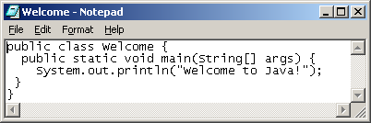
Creating, Compiling, and Running Programs

Slide 25
Compiling and Running Java from Text Pad See Supplement II.A on the Website for details

Slide 26
Compiling and Running Java from the Command Window
Set path to JDK bin directory
set path=c:\Program Files\java\jdk1.6.0\bin
Set classpath to include the current directory
set classpath=.
Compile
javac Welcome.java
Run
java Welcome

Slide 27
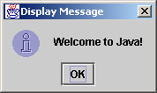
Displaying Text in a Message Dialog Box
you can use the showMessageDialog method in the JOptionPane class. JOptionPane is one of the many predefined classes in the Java system, which can be reused rather than “reinventing the wheel.”

Slide 28
The showMessageDialog Method
JOptionPane.showMessageDialog(null, "Welcome to Java!",
"Display Message", JOptionPane.INFORMATION_MESSAGE);

Slide 29
Two Ways to Invoke the Method
There are several ways to use the showMessageDialog method. For the time being, all you need to know are two ways to invoke it.
One is to use a statement as shown in the example:
JOptionPane.showMessageDialog(null, x, y,
JOptionPane.INFORMATION_MESSAGE);
where x is a string for the text to be displayed, and y is a string for the title of the message dialog box.
The other is to use a statement like this:
JOptionPane.showMessageDialog(null, x);
where x is a string for the text to be displayed.

Slide 30
Comments are almost like C++
The javadoc program generates HTML API documentation from the “javadoc” style comments in your code.
/* This kind of comment can span multiple lines */
// This kind is to the end of the line
/** * This kind of comment is a special * ‘javadoc’ style comment */

Slide 31
Object Oriented Languages -a Comparison
Objective
Feature
C++
C
Ada
Java
Encapsulation
Yes
Yes
Yes
Yes
Inheritance
Yes
Yes
No
Yes
Multiple Inherit.
Yes
Yes
No
No
Polymorphism
Yes
Yes
Yes
Yes
Binding (Early/Late)
Both
Both
Early
Late
Concurrency
Poor
Poor
Difficult
Yes
Garbage Collection
No
Yes
No
Yes
Genericity
Yes
No
Yes
No
Class Libraries
Yes
Yes
Limited
Yes

Slide 32
Java better than C++ ?
No Typedefs, Defines, or Preprocessor
No Global Variables
No Goto statements
No Pointers
No Unsafe Structures
No Multiple Inheritance
No Operator Overloading
No Automatic Coercions
No Fragile Data Types
?

Slide 33
Data Types
There are two data types available in Java:
Primitive Data Types
Reference/Object Data Types
Reference Data Types:
Reference variables are created using defined constructors of the classes. They are used to access objects.
These variables are declared to be of a specific type that cannot be changed.
For example, Employee, Puppy,etc.
Class objects and various types of array variables come under reference data type.
Default value of any reference variable is null.
A reference variable can be used to refer to any object of the declared type or any compatible type.
Example: Animal animal = new Animal("giraffe");

Slide 34
Primitive Data Types
Types
boolean either true of false
char 16 bit Unicode 1.1
byte 8-bit integer (signed)
short 16-bit integer (signed)
int 32-bit integer (signed)
long 64-bit integer (singed)
float 32-bit floating point (IEEE 754-1985)
double 64-bit floating point (IEEE 754-1985)
Java uses Unicode to represent characters internally

Slide 35
Java Literals:
Literals can be assigned to any primitive type variable. For example:
byte a =68;
char a ='A‘
when using the number systems for literals. For example:
int decimal=100;
int octal =0144;
int hexa =0x64;
String and char types of literals can contain any Unicode characters. For example:
char a ='\u0001';
String a ="\u0001";

Slide 36
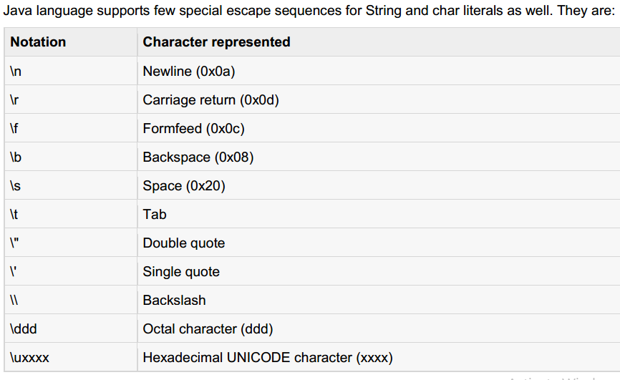

Slide 37
Java Identifiers:
In Java, there are several points to remember about identifiers. They are as follows:
All identifiers should begin with a letter (A to Z or a to z), currency character ($) or an underscore (_).
After the first character, identifiers can have any combination of characters.
A keyword cannot be used as an identifier.
Most importantly identifiers are case sensitive.
Examples of legal identifiers:age, $salary, _value, __1_value
Examples of illegal identifiers: 123abc, -salary

Slide 38
Java Modifiers:
There are two categories of modifiers:
Access Modifiers: default, public, protected, private
Non-access Modifiers: final, abstract, strictfp
Java Variables:
We would see following type of variables in Java:
Local Variables
Class Variables (Static Variables)
Instance Variables (Non-static variables)

Slide 39
Instance variables:
Instance variables are declared in a class, but outside a method, constructor or any block.
When a space is allocated for an object in the heap, a slot for each instance variable value is created
Instance variables are created when an object is created with the use of the keyword 'new' and destroyed when the object is destroyed.
Instance variables hold values that must be referenced by more than one method, constructor or block, or essential parts of an object's state that must be present throughout the class.
Instance variables can be declared in class level before or after use.
Access modifiers can be given for instance variables.
Example: Animal animal = new Animal("giraffe");

Slide 40
Instance variables Example:
public class Employee {
// this instance variable is visible for any child class.
public String name;
// salary variable is visible in Employee class only.
private double salary;
// The name variable is assigned in the constructor.
public Employee(String empName) {
name = empName;
}
// The salary variable is assigned a value.
public void setSalary(double empSal) {
salary = empSal;
}
// This method prints the employee details.
public void printEmp() {
System.out.println("name : " + name);
System.out.println("salary :" + salary);
}
public static void main(String args[]) {
Employee empOne = new Employee(“Jabir");
empOne.setSalary(1000);
empOne.printEmp();
}
}
Output:
name : jabir
salary :1000.0

Slide 41
Class/static variables:
Class variables also known as static variables are declared with the static keyword in a class, but outside a method, constructor or a block.
There would only be one copy of each class variable per class, regardless of how many objects are created from it.
Static variables are rarely used other than being declared as constants. Constants are variables that are declared as public/private, final and static. Constant variables never change from their initial value.
Static variables are stored in static memory. It is rare to use static variables other than declared final and used as either public or private constants.
Static variables are created when the program starts and destroyed when the program stops.
Static variables can be accessed by calling with the class name . ClassName.VariableName

Slide 42
Class/static variables Example:
public class Employee{
// salary variable is a private static variable
private static double salary;
// DEPARTMENT is a constant
public static final String DEPARTMENT = "Development ";
public static void main(String args[]){
salary = 1000;
System.out.println(DEPARTMENT+"average salary:"+salary);
}
}
Output: Development average salary:1000
Note: If the variables are access from an outside class the constant should be accessed as
Employee.DEPARTMENT

Slide 43
Java Access Modifiers
The four access levels are:
Visible to the package, the default. No modifiers are needed.
Visible to the class only (private).
Visible to the world (public).
Visible to the package and all subclasses (protected)
Default Access Modifier - No keyword:
Default access modifier means we do not explicitly declare an access modifier for a class, field, method, etc.
A variable or method declared without any access control modifier is available to any other class in the same package. The fields in an interface are implicitly public static final and the methods in an interface are by default public
Example :
String version ="1.5.1";
boolean processOrder(){
return true;
}

Slide 44
Private Access Modifier - private:
Methods, Variables and Constructors that are declared private can only be accessed within the declared class itself.
Private access modifier is the most restrictive access level. Class and interfaces cannot be private.
Variables that are declared private can be accessed outside the class if public getter methods are present in the class.
Using the private modifier is the main way that an object encapsulates itself and hide data from the outside world
Public Access Modifier - public:
A class, method, constructor, interface etc declared public can be accessed from any other class.
Therefore fields, methods, blocks declared inside a public class can be accessed from any class belonging to the Java Universe
Protected Access Modifier - protected:
Variables, methods and constructors which are declared protected in a superclass can be accessed only by the subclasses in other package or any class within the package of the protected members' class.
The protected access modifier cannot be applied to class and interfaces. Methods, fields can be declared protected, however methods and fields in a interface cannot be declared protected

Slide 45
Example
/* Printing ages. */
public class MyFirstJavaProgram {
public static void main (String args[]) {
int myAge, myFriendAge; /* declare two integer variables */
myAge = 20;
myFriendAge = myAge + 1; //one year older
System.out.println(“Hello, I am “ +myAge + “years old, and my friend is “ + myFriendAge + “ years old”);
System.out.println(“Goodbye”);
} // end of main
} // end of class

Slide 46
Reading from user (Input)
public class MyFirstJavaProgram{
public static void main (String args[]) {
/* this line should appear once in your program; basically it declares a variable r which knows how read input from the user */
Scanner in=new Scanner(System.in);
/* Then you can use num1=in.nextInt() to read an integer value from the user. */
/* Then you can use num2=in.nextLine() to read an string value from the user. */
System.out.print(“Dear user, please enter an integer number:”);
int num1;
String num2;
num1=in.nextInt();
num2=in.nextLine();
} // end of main
} // end of class

Slide 47
An example of a class
Variable
class Person { String name; int age;
void birthday ( ) { age++; System.out.println (name + ' is now ' + age); } }
Method

Slide 48
Scoping
As in C/C++, scope is determined by the placement of curly braces {}.
A variable defined within a scope is available only to the end of that scope.
{ int x = 12;
/* only x available */
{ int q = 96;
/* both x and q available */
}
/* only x available */
/* q “out of scope” */
}
This is ok in C/C++ but not in Java.
{ int x = 12;
{ int x = 96; /* illegal */
}
}

Slide 49
Java Basic Operators
Arithmetic Operators
Relational Operators
Bitwise Operators
Logical Operators
Assignment Operators
Misc Operators

Slide 50
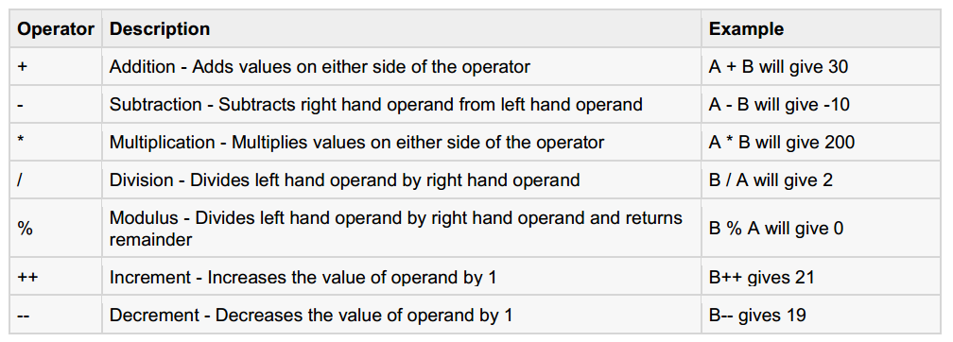
Arithmetic Operators

Slide 51
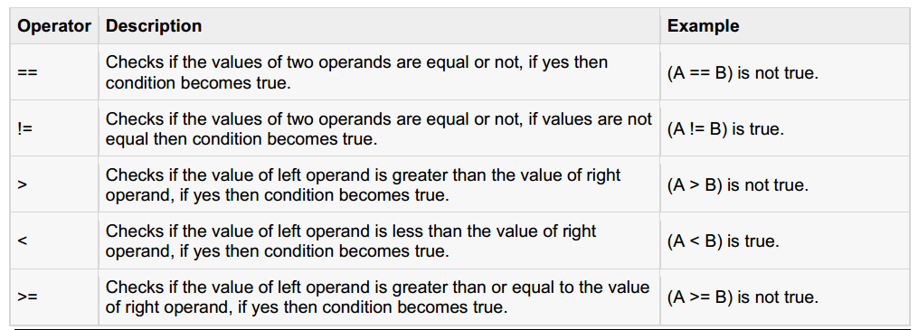
The Relational Operators:

Slide 52
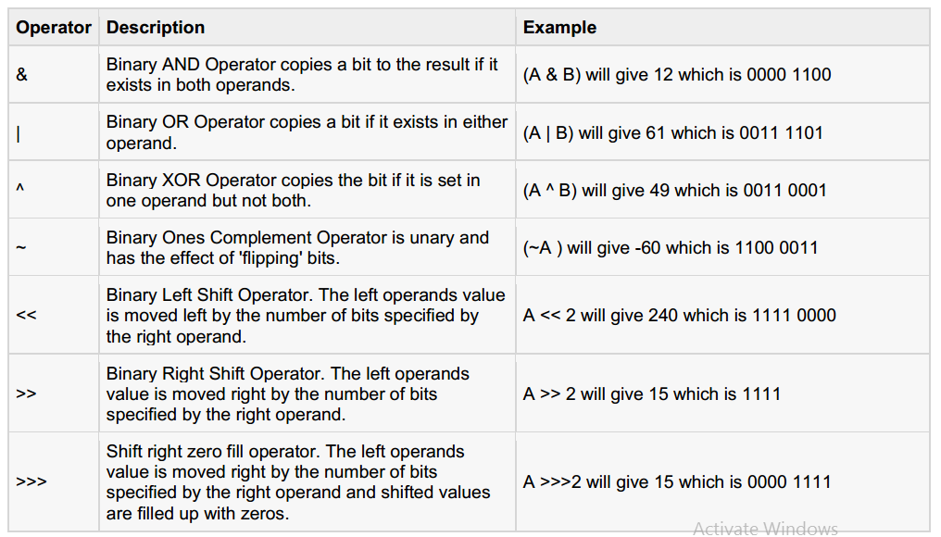
The Bitwise Operators:
a = 0011 1100
b = 0000 1101
-----------------
a&b = 0000 1100
a|b = 0011 1101
a^b = 0011 0001
~a = 1100 0011

Slide 53
The Bitwise Operators Example:
public class Test{
public static void main(String args[]){
int a =60; /* 60 = 0011 1100 */
int b =13; /* 13 = 0000 1101 */
int c =0;
c = a & b; /* 12 = 0000 1100 */
System.out.println("a & b = "+ c );
c = a | b; /* 61 = 0011 1101 */
System.out.println("a | b = "+ c );
c = a ^ b; /* 49 = 0011 0001 */
System.out.println("a ^ b = "+ c );
c =~a; /*-61 = 1100 0011 */
System.out.println("~a = "+ c );
c = a <<2; /* 240 = 1111 0000 */
System.out.println("a << 2 = "+ c );
c = a >>2; /* 215 = 1111 */
System.out.println("a >> 2 = "+ c );
c = a >>>2; /* 215 = 0000 1111 */
System.out.println("a >>> 2 = "+ c );
}
}
Output;
a & b =12
a | b =61
a ^ b =49
~a =-61
a <<2=240
a >>15
a >>>15

Slide 54
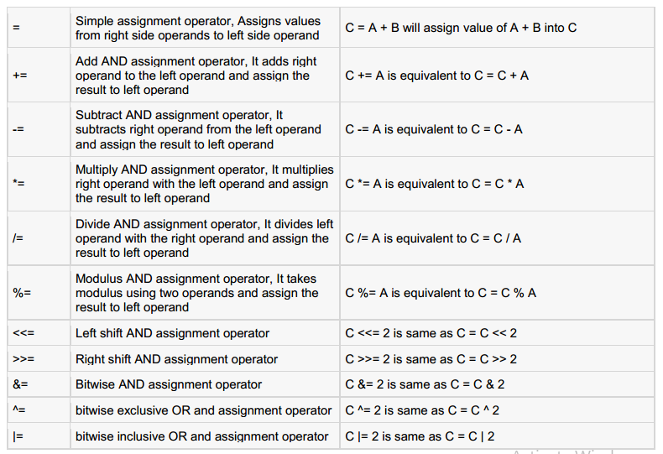
The Assignment Operators:

Slide 55
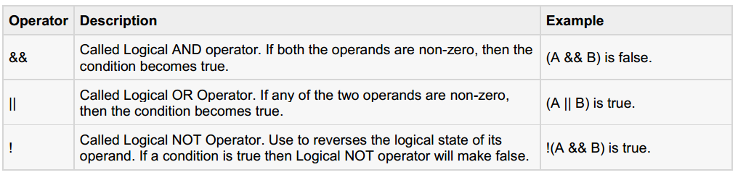
The Logical Operators:

Slide 56
Misc Operators
Conditional Operator (?:):
Conditional operator is also known as the ternary operator.
This operator consists of three operands and is used to evaluate Boolean expressions.
The goal of the operator is to decide which value should be assigned to the variable.
The operator is written as:
variable x =(expression)? value iftrue: value iffalse
public class Test{
public static void main(String args[]){
int a , b;
a =10;
b =(a ==1)?20:30;
System.out.println("Value of b is : "+ b );
b =(a ==10)?20:30;
System.out.println("Value of b is : "+ b );
}
}
Output:
Value of b is:30
Value of b is:20

Slide 57
Misc Operators (cont..)
instanceof Operator:
This operator is used only for object reference variables.
The operator checks whether the object is of a particular type(class type or interface type).
instanceof operator is wriiten as:
(Object reference variable ) instanceof (class/interface type)
Class Vehicle
{
}
public class Car extends Vehicle{
public static void main(String args[]){
Vehicle a =new Car();
boolean result = a instanceof Car;
System.out.println(result);
}
}
Output:
true

Slide 58
If statements
if (condition) {
//instructions
}
else {
//instructions
}
//instructions
True
False
condition
instructions
instructions
instructions

Slide 59
Boolean conditions
Comparison operators
== equal
!= not equal
< less than
> greater than
<= less than or equal
>= greater than or equal
Example:
int x, y; //two variables
//assume they have some values
if (x <= y) {
System.out.println(“x is smaller”);
} else {
System.out.println(“x is larger”);
}

Slide 60
Methods, arguments and return values
Java methods are like C/C++ functions. General case:
returnType methodName ( arg1, arg2, … argN) {
methodBody
}
The return keyword exits a method optionally with a value
int storage(String s) {return s.length() * 2;}
boolean flag() { return true; }
float naturalLogBase() { return 2.718f; }
void nothing() { return; }
void nothing2() {}

Slide 61
An array is an object
Person mary = new Person ( );
int myArray[ ] = new int[5];
int myArray[ ] = {1, 4, 9, 16, 25};
String languages [ ] = {"Prolog", "Java"};
Since arrays are objects they are allocated dynamically
Arrays, like all objects, are subject to garbage collection when no more references remain
so fewer memory leaks
Java doesn’t have pointers!

Slide 62
Array Operations
Subscripts always start at 0 as in C
Subscript checking is done automatically
Certain operations are defined on arrays of objects, as for other classes
e.g. myArray.length == 5

Slide 63
Example Programs

Slide 64
Echo.java
C:\UMBC\331\java>type echo.java
// This is the Echo example from the Sun tutorial
class echo {
public static void main(String args[]) {
for (int i=0; i < args.length; i++) {
System.out.println( args[i] );
}
}
}
C:\UMBC\331\java>javac echo.java
C:\UMBC\331\java>java echo this is pretty silly
this
is
pretty
silly
C:\UMBC\331\java>

Slide 65
Factorial Example
public class Factorial { // Define a class
public static void main(String[] args) { // The program starts here
int input = Integer.parseInt(args[0]); // Get the user's input
double result = factorial(input); // Compute the factorial
System.out.println(result); // Print out the result
} // The main() method ends here
public static double factorial(int x) { // This method computes x!
if (x < 0) // Check for bad input
return 0.0; // if bad, return 0
double fact = 1.0; // Begin with an initial value
while(x > 1) { // Loop until x equals 1
fact = fact * x; // multiply by x each time
x = x - 1; // and then decrement x
} // Jump back to the star of loop
return fact; // Return the result
} // factorial() ends here
} // The class ends here

Slide 66
JAVA Classes
The class is the fundamental concept in JAVA (and other OOPLs)
A class describes some data object(s), and the operations (or methods) that can be applied to those objects
Every object and method in Java belongs to a class
Classes have data (fields) and code (methods) and classes (member classes or inner classes)
Static methods and fields belong to the class itself
Others belong to instances

Slide 67
Scope of Objects
Java objects don’t have the same lifetimes as primitives.
When you create a Java object using new, it hangs around past the end of the scope.
Here, the scope of name s is delimited by the {}s but the String object hangs around until GC’d
{
String s = new String("a string");
} /* end of scope */

Slide 68
Example
public class Circle {
// A class field
public static final double PI= 3.14159; // A useful constant
// A class method: just compute a value based on the arguments
public static double radiansToDegrees(double rads) {
return rads * 180 / PI;
}
// An instance field
public double r; // The radius of the circle
// Two methods which operate on the instance fields of an object
public double area() { // Compute the area of the circle
return PI * r * r;
}
public double circumference() { // Compute the circumference of the circle
return 2 * PI * r;
}
}

